Slide 1
Learning to fish
Searching the literature
Notes:
https://www.flickr.com/photos/maisonbisson/1093979536/

Slide 2
Outline.
Search process.
Biomedical databases.
Saving your searches.
Managing your results.

Slide 3
Search Process
Notes:
https://www.flickr.com/photos/edith_soto/7271415680/

Slide 4
Building the search.
What is my search question? What am I trying to answer?
What are all the terms/keywords that can be used to describe my topic(s)?
Where is the best place to find information on this topic?

Slide 5
The question.
What is the most accurate method for assessing temperature in children who come to the Emergency Department?

Slide 6
The question.
What is the most accurate method for assessing temperature in children who come to the Emergency Department?

Slide 7
The question.
What is the most accurate method for assessing temperature in children who come to the Emergency Department?

Slide 8
The question.
What is the most accurate method for assessing temperature in children who come to the Emergency Department?

Slide 9
The question.
What is the most accurate method for assessing temperature in children who come to the Emergency Department?

Slide 10
The question.
What is the most accurate method for assessing temperature in children who come to the Emergency Department?

Slide 11
PICO(T).
P = Patient/Problem/Population How would you describe a group of patients similar to yours? What are the most important characteristics of the patient?
I = Intervention What main intervention, prognostic factor, or exposure are you considering? C = Comparison What is the main alternative you are considering, if any? Not always necessary. O = Outcome What do you hope to accomplish, measure, or improve? T = Type of Question/Study Are you asking a question of therapy, diagnosis, etiology/harm, prognosis, or prevention? Are you looking for randomized controlled trials (RCT), cohort studies, or economic analyses?

Slide 12
PICO(T).
P = Patient/Problem/Population Children in the ED.
I = Intervention Temperature assessment. C = Comparison N/A OR Different temperature assessments if you are comparing. O = Outcome Accurate temperature assessment.

Slide 13
Keywords.
Concepts:
Child.
Emergency department.
Temperature assessment.

Slide 14
Keywords.
Concepts:
Child.
Children
Youth
Kid
Kids
Emergency department.
Temperature assessment.

Slide 15
Keywords.
Concepts:
Child.
Emergency department.
Emergency room
Emergency ward
Emergency medicine
Temperature assessment.

Slide 16
Keywords.
Concepts:
Child.
Emergency department.
Temperature assessment.
Temperature
Temperatures
Temperature measurement

Slide 17
Grouping concepts with OR.
Child.
(child OR children OR youth OR kid OR kids)
Emergency department.
(emergency department OR emergency room OR ER OR ED OR emergency medicine)
Temperature assessment.
(temperature OR temperatures OR temperature assessment OR temperature measurement)

Slide 18
Combining concepts with AND.
(child OR children OR youth OR kid OR kids)
AND
(emergency department OR emergency room OR ER OR ED OR emergency medicine)
AND
(temperature OR temperatures OR temperature assessment OR temperature measurement)

Slide 19
Biomedical Databases
Notes:
https://www.flickr.com/photos/shindotv/3835365695/

Slide 20
PubMed / Medline.
Database of 24+ million citations.
Premier biomedical database.
Contains sophisticated vocabulary for searching the literature (MeSH).

Slide 21
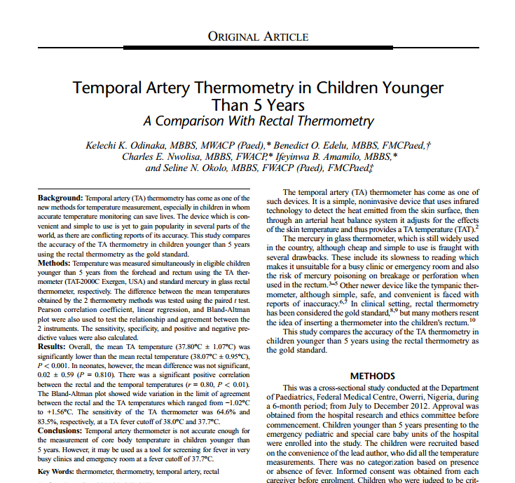
Medical Subject Headings (MeSH)
Children
Child, Preschool
Temperature
Body Temperature
Thermometers

Slide 22
Search terms.
(child OR children OR youth OR kid OR kids)
(emergency department OR emergency room OR ER OR ED OR emergency medicine)
(temperature OR temperatures OR temperature assessment OR temperature measurement)

Slide 23
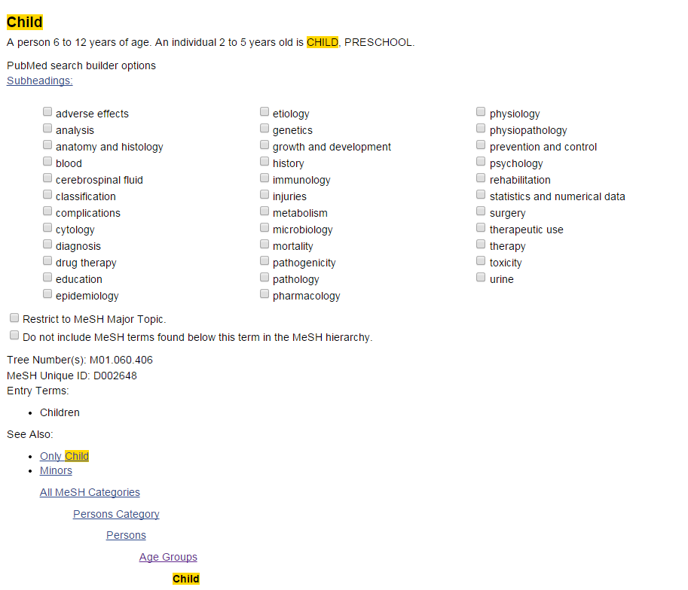
Searching MeSH.
http://www.ncbi.nlm.nih.gov/mesh

Slide 24
Adding MeSH to your search.
(child OR children OR youth OR kid OR kids OR child[mesh])
AND
(emergency department OR emergency room OR ER OR ED OR emergency medicine OR emergency service, hospital[mesh])
AND
(temperature OR temperatures OR temperature assessment OR temperature measurement OR body temperature[mesh])

Slide 25
PubMed / Medline.
Other search tips.
[tiab]: Will search terms in title and abstract
[ot]: Will search terms only in author supplied keywords
[au]: Will search for the author

Slide 26
Adding [tags] to your search.
(child[tiab] OR children[tiab] OR youth[tiab] OR kid[tiab] OR kids[tiab] OR child[mesh])
AND
(emergency department[ot] OR emergency room[ot] OR ER[ot] OR ED[ot] OR emergency medicine[ot] OR emergency service, hospital[mesh])
AND
(temperature OR temperatures OR temperature assessment OR temperature measurement OR body temperature[mesh])

Slide 27
Other databases.
Embase.
European focused biomedical and pharmacological database of 8+ million citations
Cochrane Library.
Database of systematic reviews, trials, methods, technology assessments
Web of Science.
Database that shows # of times articles have been cited, covers biomedical research

Slide 28
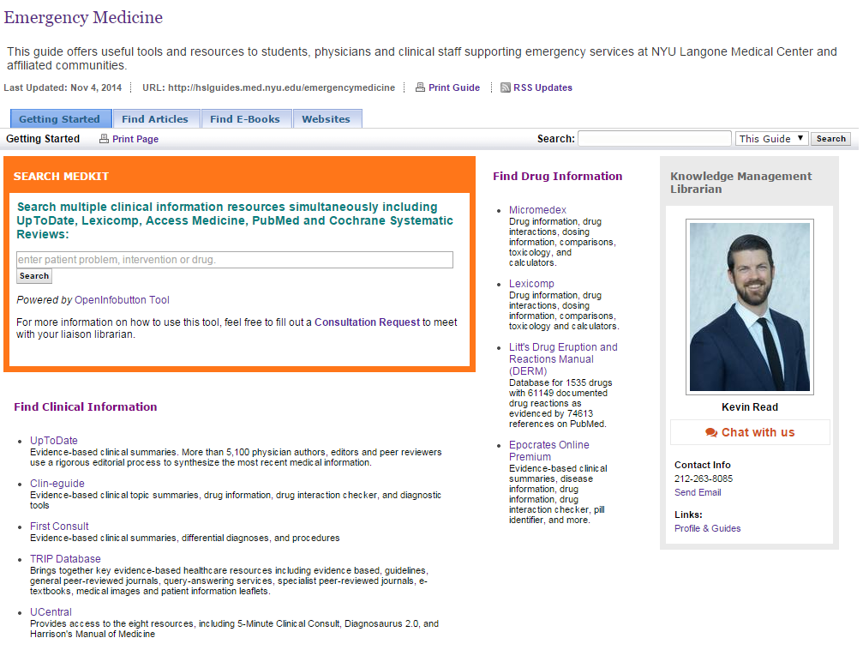
Your ED guide.
http://hslguides.med.nyu.edu/emergencymedicine/getting-started

Slide 29
your searches.
Notes:
https://www.flickr.com/photos/59937401@N07/7214441194/

Slide 30
Document it.
Date: April 1, 2014
Time: 12:55pm
Database: Medline
Results: 109
Search Concept | Keywords used | Subject headings used | Full search
Child | Child Youth Children Kid Kids | Child[mesh] | (child[mesh] OR child OR youth OR children OR kid OR kids)
Emergency Departments | emergency department emergency ward emergency room | “Emergency service, hospital”[mesh] | (“Emergency service, hospital”[mesh] OR emergency department OR emergency ward OR emergency room)
Temperature measurements | Temperature measurement temperature temperature assessment | “Body temperature”[mesh] | (“Body temperature”[mesh] OR temperature measurement OR temperature assessment)

Slide 31
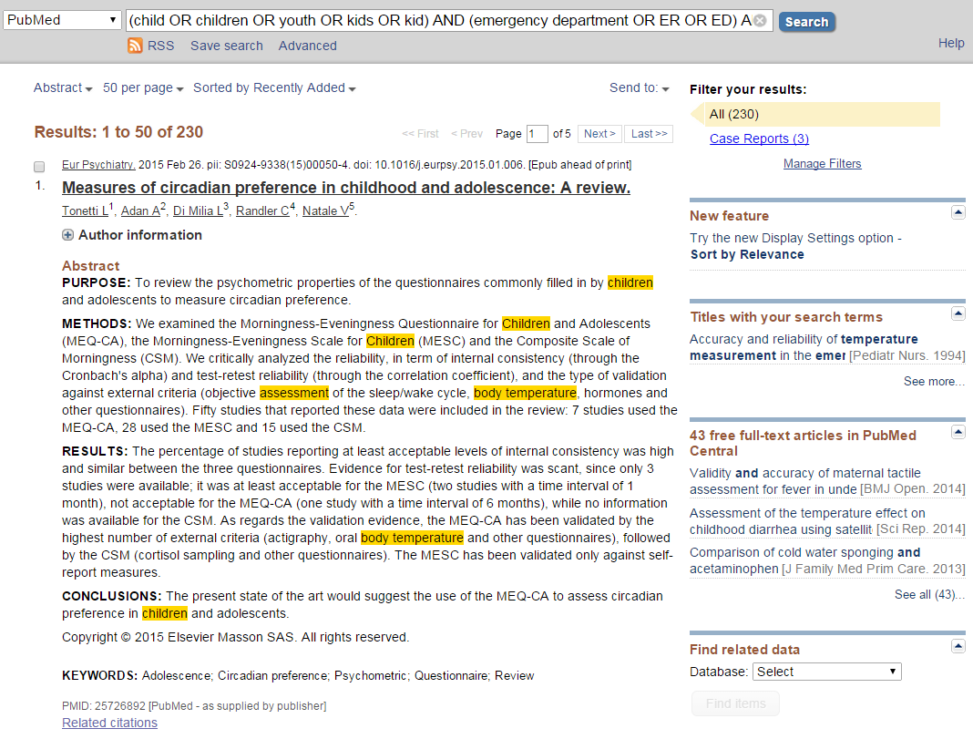
Save it.

Slide 32
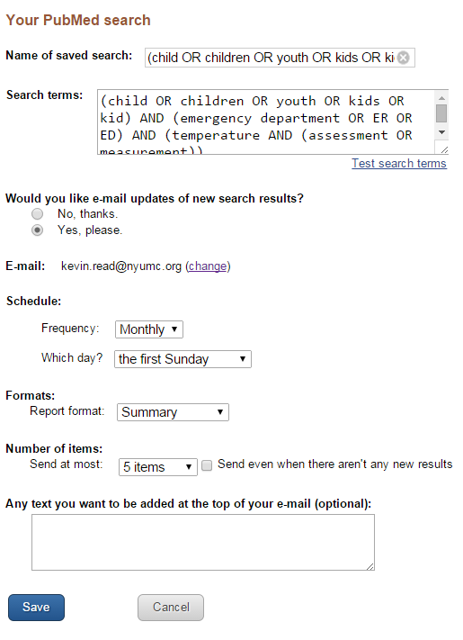
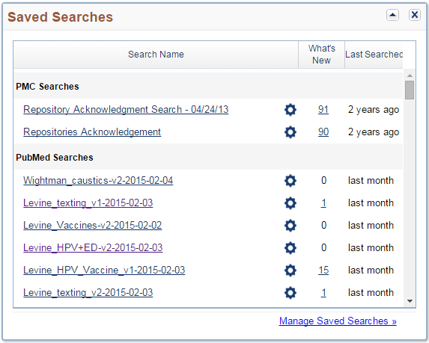
Save it.

Slide 33
Organizing your literature
Notes:
https://www.flickr.com/photos/scalino/6629580443/

Slide 34
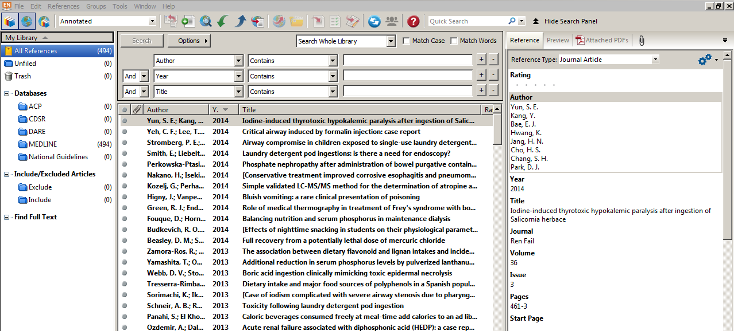
Endnote.

Slide 35
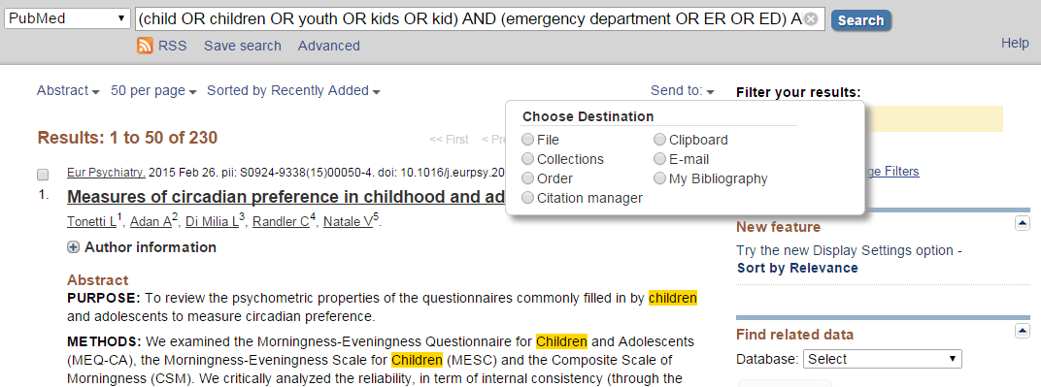
Exporting to Endnote.

Slide 36
Exporting to Endnote.

Slide 37
Endnote & Word.

Slide 38
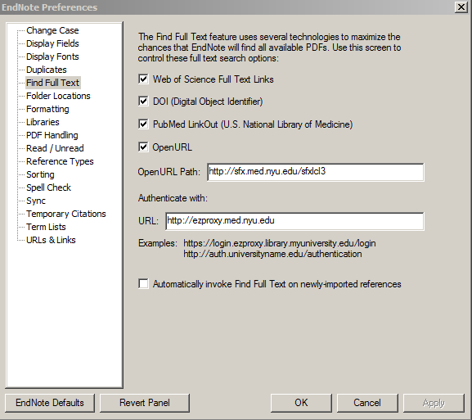
Endnote & NYUHSL.
http://hsl.med.nyu.edu/sites/default/files/handouts/EndNoteX7Handout_3_2014.pdf

Slide 39
Takeaways.
Search process
Refine your question(s)
Define your parameters
Think of all possible synonyms
Use trusted biomedical databases.
Which databases will find you the best results?
What features will help refine your search?

Slide 40
Takeaways.
Save your searches.
Document your searches
Save them with MyNCBI
Manage your results.
Use Endnote (or something similar)
Build Inclusion/Exclusion folders to sift through results

Slide 41
Q & A.
kevin.read@nyumc.org

